Slide 1

Flight Delay Prediction
A Machine Learning Approach for Minimizing Controllable Delays in Air Travel

Slide 2

Project Objectives & Motivation
Project Goals:
Understand key causes and patterns behind delays
Build models to predict:
Whether a flight will be delayed (Classification)
How long the delay will be (Regression)
Highlight controllable delays (e.g., Carrier, Late Aircraft)
Enable operational decision-making via interpretable ML
Air travel is essential in today’s global economy, yet delays disrupt passengers and incur massive costs to airlines.
Why This Matters: Delays cost billions in operational disruptions. A predictive and explainable system improves both efficiency and passenger experience.

Slide 3
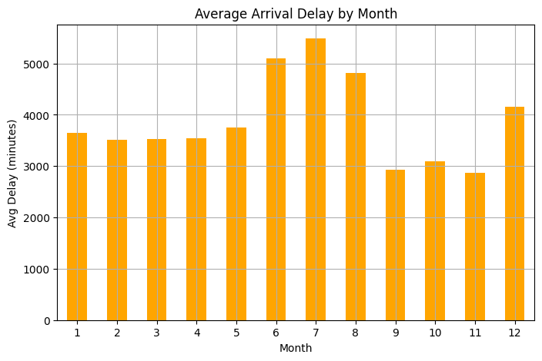
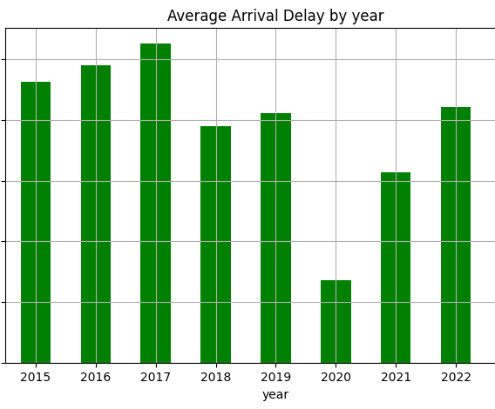
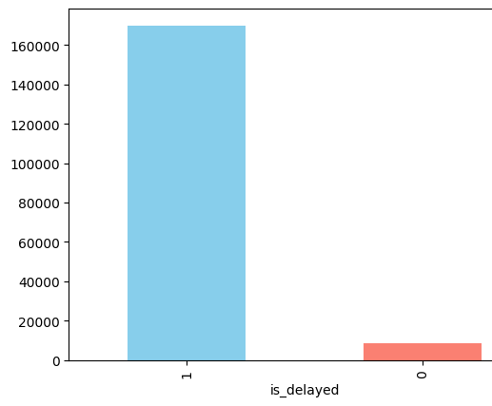
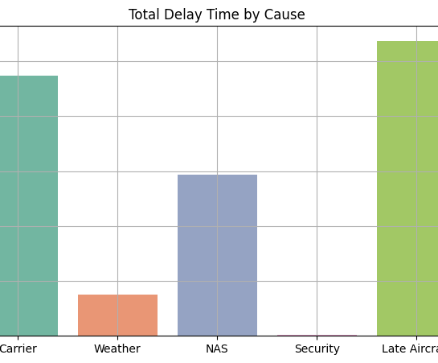
Key Insights from EDA
is_delayed feature (1 for delays ≥15 mins, 0 otherwise) showed a highly imbalanced distribution, with most flights being not on time. This imbalance was addressed during modeling to ensure the classifier doesn’t bias toward the majority class.
Late Aircraft and Carrier delays contribute the most to total delay time, indicating major operational bottlenecks. In contrast, Weather, NAS, and Security delays are relatively lower, highlighting the potential for controlling delays internally.
Arrival delays peak from July to December, likely due to holiday traffic and adverse weather. Lower delays in spring months suggest seasonal patterns that airlines can leverage for better planning.
The average arrival delay peaked in 2017 and showed a significant drop in 2020, likely due to reduced air traffic during the pandemic. Delay levels have gradually increased again post-2020, stabilizing around pre-pandemic figures by 2023.

Slide 4
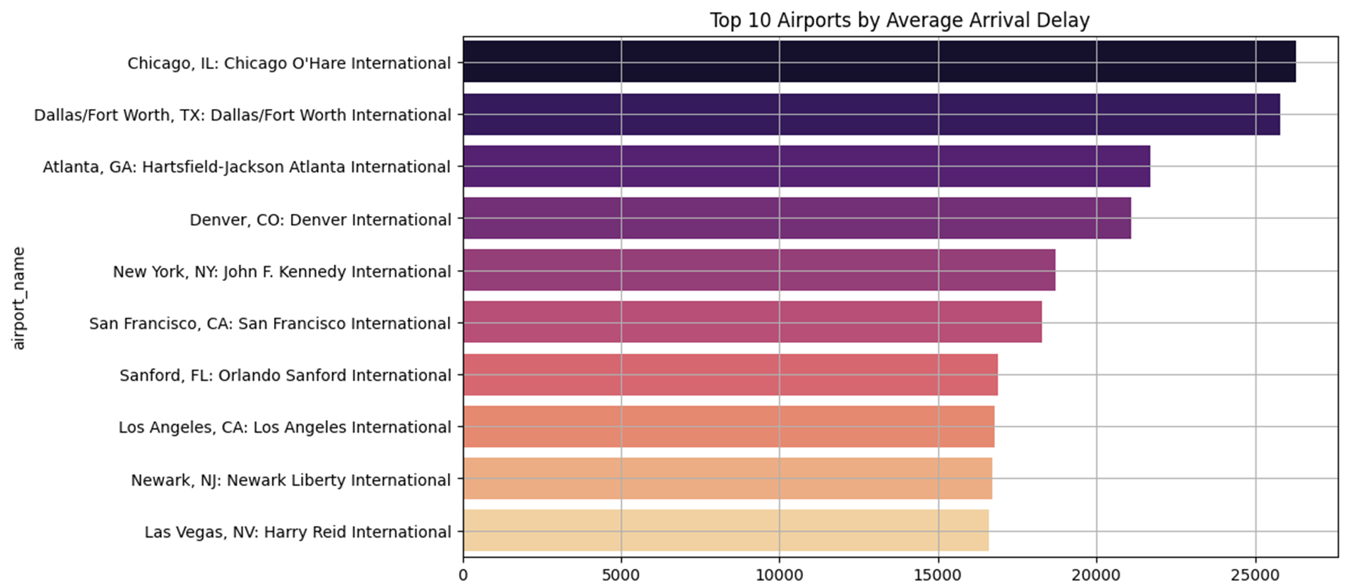
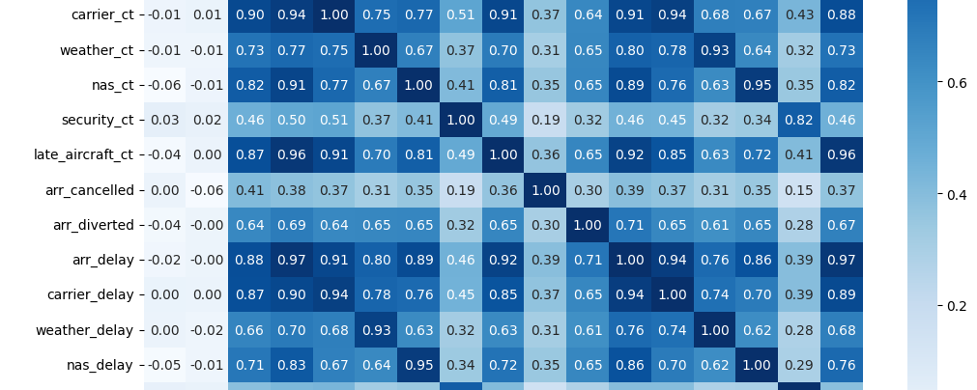
Correlation Heatmap
The correlation heatmap shows weak correlations between most features, indicating low multicollinearity. This suggests that each feature contributes independently to the delay prediction model.
Top 10 Airport by average arrival delay
The top 10 airports by average arrival delay reveal consistently high delays at major hubs, likely due to heavy traffic and congestion. These airports may benefit from targeted operational improvements to reduce arrival bottlenecks.

Slide 5
Methodology & Models
SHAP-Based Explainability
Applied SHAP (Shapley values) to interpret feature contributions
Found key drivers: scheduled departure time, carrier, origin airport
Aligned with Operational Adjustability focus (controllable delays)
OAI-Focused Model
Introduced Operational Adjustability Index (OAI)
Trained a regressor specifically to minimize controllable delay types
Combined SHAP + OAI to prioritize actionable insights
Regression for Delay Duration
Built a regression model to estimate delay in minutes
Evaluated using MAE and RMSE
Preprocessing
Cleaned missing data, feature encoding, standard scaling
Feature Engineering
Created is_delayed target Removed irrelevant columns
Final Model Selection
Re-trained models with cleaned features
Random Forest Classifier emerged as best performance Balanced precision, recall, and AUC-ROC
Robust to non-linear relationships and outliers
Tried Multiple Models
Evaluated models: Logistic Regression, Decision Tree, Random Forest, Gradient Boosting
All models initially showed ~100% accuracy due to data leakage
Initial Modeling
Started with Logistic Regression as baseline
Found class imbalance (most flights on time) → accuracy misleadingly high
Feature Engineering & Leakage Handling
Identified and removed leakage features (e.g., actual arrival time, arrival delay itself)
Re-engineered features to use only pre-departure information

Slide 6
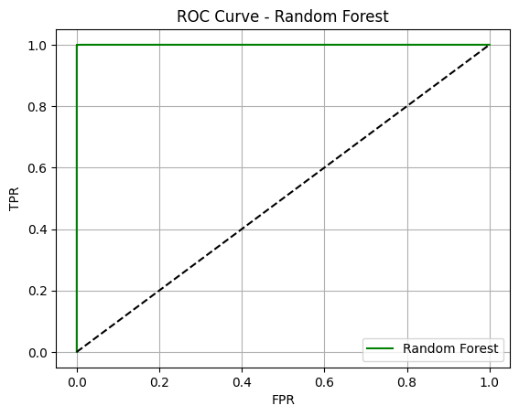
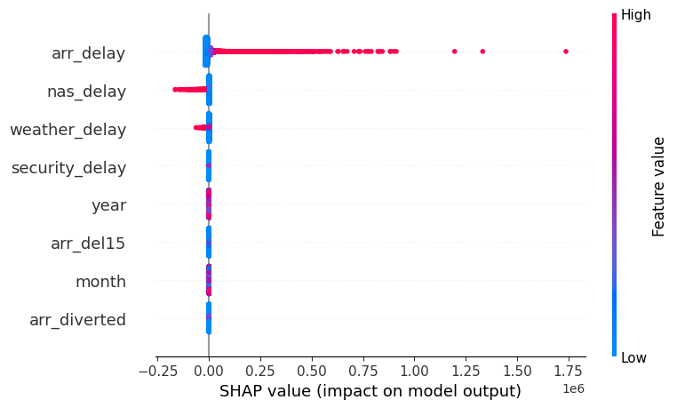
Model Performance & Explainability
Model Evaluation (Random Forest Classifier)
Accuracy: ~100% (initially due to leakage — resolved later)
Precision, Recall, F1-score: All balanced post-cleaning
AUC-ROC Score:
Random Forest AUC ≈ 0.933
Significantly higher than Logistic Regression (AUC ≈ 0.84)
Demonstrates better separability between delayed and on-time flights
SHAP (Explainable ML) Analysis
SHAP summary plot identified top contributors:
arr_delay, nas_delay, weather_delay, etc.
High SHAP impact of arr_delay and arr_del15 confirmed data leakage, leading to:
Feature elimination
Retraining the model with only pre-departure features
SHAP was also applied on the final cleaned model to ensure transparency & trust in predictions

Slide 7




Actionable Recommendations
System-Level Improvements:
Integrate real-time OAI delay prediction in airline dashboards
Prioritize flights where delay cause is actionable
Strategic Benefit: This approach helps minimize avoidable delays → enhancing customer satisfaction, reducing cascading disruptions, and optimizing operations.
Carrier-Level Recommendations:
Optimize crew scheduling & aircraft readiness
Implement buffer time during high-risk slots (evening departures)
Airport-Level Strategies:
Allocate extra ground crew at busy hubs
Monitor airport-level congestion patterns

Slide 8
Thank YOU
Name- Shikha Bharti
Enrolment- 21321028

